Slide 1
iCIMS 16.3 Release: Highlights
Last Updated Date: 7/18/2016

Slide 2
Introducing the 16.3 Release
The 16.3 Release includes significant enhancements to iCIMS Connect and iCIMS Recruit. With this release, users will be able keep track of excellent candidates via configurable tags, and those with Connect and Recruit will benefit from more automated engagement and tracking opportunities for passive and active candidates.
Major new features include:
Updated Login Screen: Log in to the iCIMS Talent Platform from an improved user interface.
Candidate Tagging: Add specific searchable keywords to a candidate’s profile.
Talent Pool Visualization: Easily review the candidates that make up your Connect talent pools.
Candidate Job Recommendations: Automatically re-engage interested passive candidates with reoccurring job digests.
Recommended Talent Pools after Job Application: Encourage active candidates to subscribe to related talent pools.
Improved Automation between Connect and Recruit: Automatically remove candidates who are active on a job from job digests or email campaigns using new and existing settings. Once candidates are no longer active on a job, they can automatically receive messages related to their talent pools again.

Slide 3
Updated Login Screen
With the 16.3 Release, iCIMS is excited to introduce a new login screen.
The new login screen offers the same functionality and configuration as the previous login screen, with a sleeker and more polished interface.

Slide 4
Candidate Tagging
Users can now add searchable tags to a candidate’s profile. These tags are visible in the candidate’s Quick Info Card as well as on the Contact Tab.
Users with search permissions can easily view other candidates with the same trait by clicking the tag on a candidate’s profile.
Clients can choose which user groups are able to create new tags, including the ability to add new tag values directly on a candidate’s profile.

Slide 5
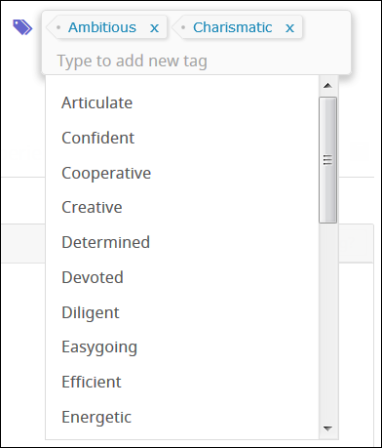
Candidate Tagging
To help clients get started, the system includes a pre-created list of tags.
Tag lists are flexible and configurable. The user admin can update the tags list to include any characteristics the organization wants to track.
Tags can even be used to keep track of particularly impressive or “Silver Medalist” candidates so that it’s easy to find great talent when the next opening becomes available.

Slide 6
Talent Pool Visualization
On the Talent Pool Profile, users with iCIMS Connect enabled can now see candidates in the talent pool in various groupings, including by status, by source, and by date added.
These groupings offer a chart view as well as a detailed view, similar to the view options available on the Recruiting Workflow Profile.
Users can also filter results within the groupings to see only candidates who have uploaded a resume or who live within a certain distance, among other options.

Slide 7
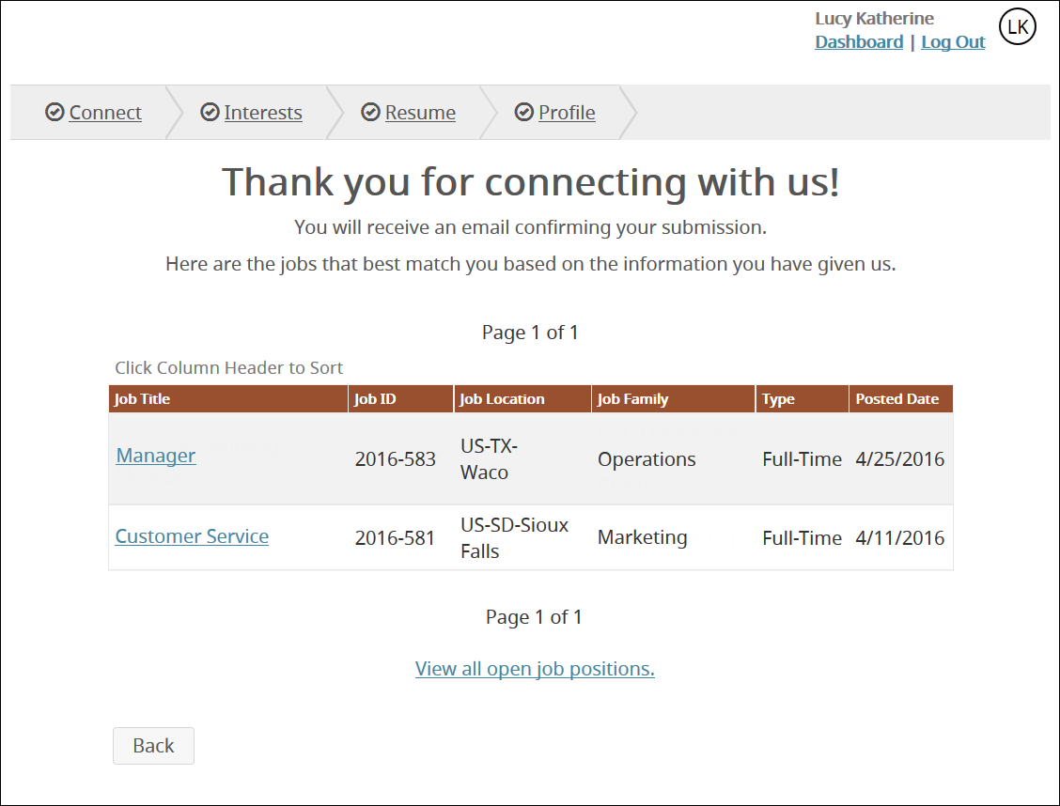
Candidate Job Recommendations
Candidate Job Recommendations is a powerful new feature that requires both Connect and Recruit to be enabled in your system.
This feature is off by default, as the user admin must take setup actions prior to enabling the feature. For additional information, access the Candidate Job Recommendations Setup Guide.
Among other benefits, this feature displays jobs to passive candidates based on their interests after they connect with an organization.

Slide 8
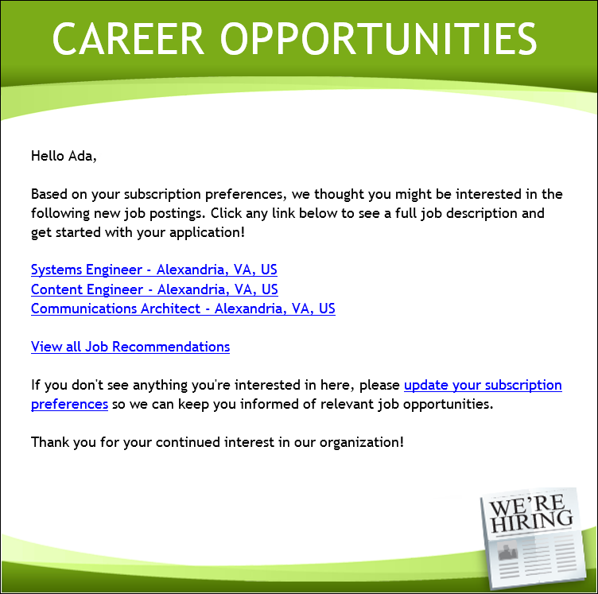
Candidate Job Recommendations
The Candidate Job Recommendations feature also automatically sends interested passive candidates a weekly job digest related to their subscribed talent pools.
Candidates opt in to these emails on the Connect Portal and then receive regular emails with links to newly-posted jobs related to their interests.

Slide 9
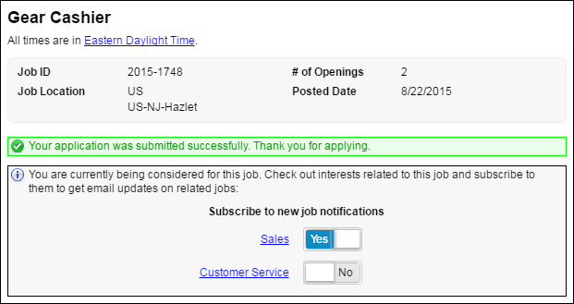
Recommended Talent Pools after Job Application
Clients with Connect and Recruit also benefit from the ability to display related talent pools to candidates after they have applied for a job.
Like Candidate Job Recommendations, this feature requires setup steps—specifically, the association of specific talent pools to jobs.

Slide 10
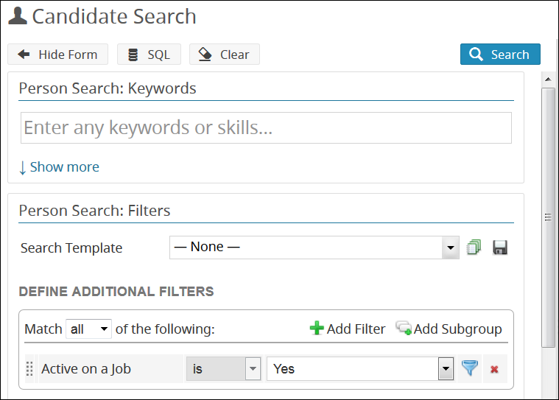
Improved Automation between Connect & Recruit
Using the Active on a Job property introduced in the 16.2 Update, the system allows the user admin to remove active candidates from job digests.*
Additionally, this search filter can be used to remove active candidates from email campaigns, if desired.
When a candidate is no longer active on a job, they will begin to receive job digests and other applicable communications again.
*For additional information on enabling this aspect of the feature, refer to the Job Recommendation Email Subscription Management section of the 16.3 Release Notes.

Slide 11
Additional Release Resources
Release Notes
In-depth details on all new release features, including detailed setup information for user admins.
See https://icimshub.force.com/customer/releaseresources
iCIMS iCARE Site, Knowledge Base, and Training Videos
How-to articles, video trainings, and other useful information in an easy-to-search format.
See https://icimshub.force.com/customer
iCIMS Browser Support Policy
Information about supported web browsers, updated by release or as needed.
See http://media.icims.com/training/Training/Documentation/iCIMS_Browser_Support_Policy.pdf
This information has been provided ahead of release and is subject to change.
For more information, please speak with your Account Manager or visit the iCIMS Release Resources site for updated information as it becomes available.

