Slide 1
iCIMS 16.4 Release: Highlights
Last Updated Date: 10/14/2016

Slide 2
Introducing the 16.4 Release
The 16.4 Release includes a new profile design that makes it simpler for you to see rich at-a-glance detail related to the information that’s relevant to you. If you have an interest in increasing quality-of-hire and decreasing time-to-fill by improving your approach to hiring events and recruitment marketing strategies, 16.4 also includes significant new developments within iCIMS Connect.
Reach out to your iCIMS Account Manager to learn more about candidate relationship management tools available as part of iCIMS Connect, like event management, job recommendations, email campaigns, and more!

Slide 3
Major New Features in 16.4
Major new features include:
Profile Redesign: Access important profile information in the form of configurable factoids and a filterable activity stream, packaged together in a sleek new user interface.
Connect Candidate Activity Level: Quickly discover which candidates are the most actively engaged.
Connect Event Management: Better organize your organization’s hiring events with new Event Profiles and an Event Manager page.
Connect Kiosk Enhancements: Allow candidates to pre-register for events and check-in at your organization’s kiosk, and even take and upload a photo of their resume on your kiosk.
Connect Recruiter Review: Easily provide feedback about candidates who have attended a recruiting event from your mobile device or tablet.

Slide 4
Profile Redesign
On by default
All profiles in the iCIMS Talent Platform (except Room Profiles) have been redesigned, making essential information more readily accessible.
Each profile now features a profile card, factoids, and a recent activity feed, as well as general UI updates and an improved split-screen functionality.
The profile card features key details about the person, job, etc.
Factoids and the recent activities feed highlight the essential need-to-knows right up front.
The improved split-screen view allows users to anchor profile tabs the third column, providing quick access to even more information on candidates or jobs.
iCIMS released early previews of Profile Redesign to customers as part of a Feature Beta Release designed to solicit feedback and improve the design before its 16.4 launch.
Some client ideas that were implemented for Profile Redesign include:
Improved split-screen view
Configurable factoids
Activity filtering
Clickable entries in the recent activity feed

Slide 5
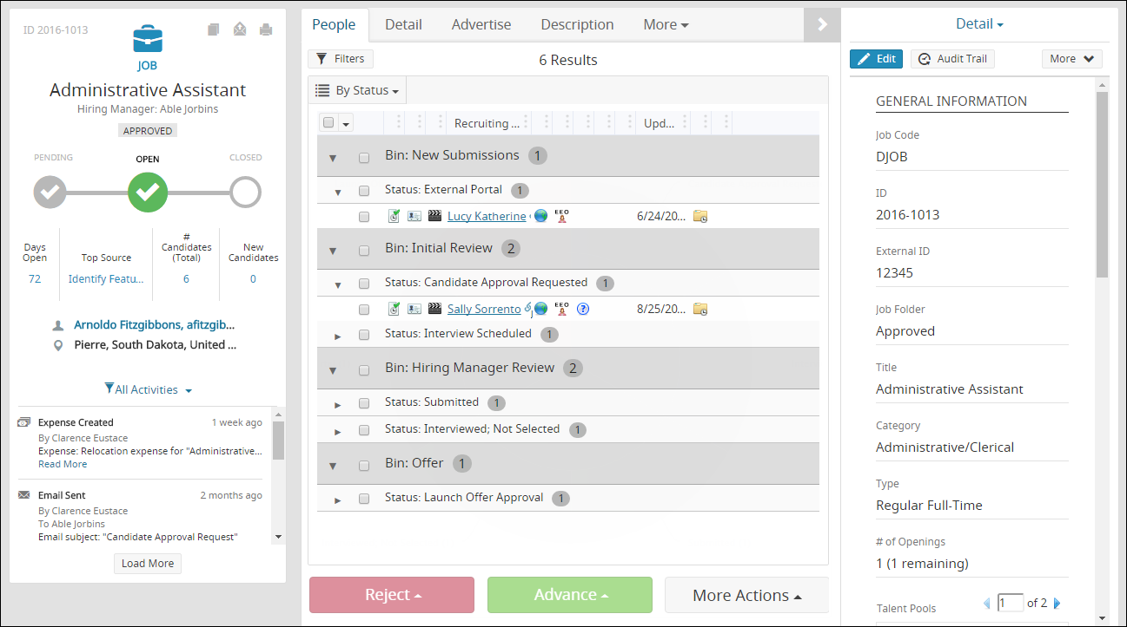
Profile Redesign (Cont’d)
On by default
Profile Card
Improved Split-Screen View & Enhanced UI
Factoids
Recent Activity Feed

Slide 6
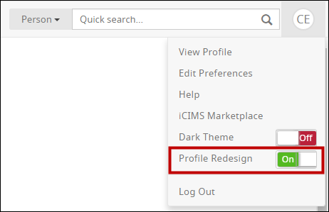
Profile Redesign
On by default
By default, Profile Redesign is on for all existing clients. However, individual users may enable/disable Profile Redesign as desired by simply clicking their initials/profile picture on the far right of the menu bar and adjusting the switch for the Profile Redesign option available in the menu.
User admins can also choose to enable/disable Profile Redesign globally or for specific user groups, and disallow users from changing that setting themselves, if desired. See the iCIMS Knowledge Base for more information.
As a reminder, Profile Redesign will be the only available view starting in early 2017 with our next major release. For that reason, iCIMS recommends leaving Profile Redesign on for all users.

Slide 7
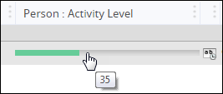
Candidate Activity Level
Connect only
The new Candidate Activity Level feature in iCIMS Connect allows recruiters to quickly discover which candidates are the most actively engaged.
A candidate’s Activity Level score is calculated based on:
Emails Sent, Emails Opened, and Email Links Clicked
Portal Logins
Job Applications Completed
Resumes Updated
Activity Level is available on the Talent Pool People Tab and as an output column in various searches.
A horizontal bar graph appears next to each candidate’s name, which corresponds to their Activity Level score.
Clicking the green bar brings up the candidate’s Activity Level snapshot.

Slide 8
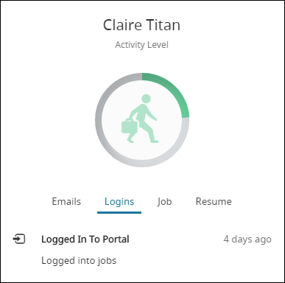
Candidate Activity Level (Cont’d)
Connect only
Each candidate’s Activity Level snapshot features a circular icon with their Activity Level score, plus a stream of their recent activities.
The amount of green around the circle represents the candidate's Activity Level score. The icon looks dark when the score is 50 and above, and more faded when it is below 50.
Underneath the icon is the Activity Stream—a listing of activities initiated by the candidate, broken up into four sections.
Activity Level Icon
Activity Stream

Slide 9
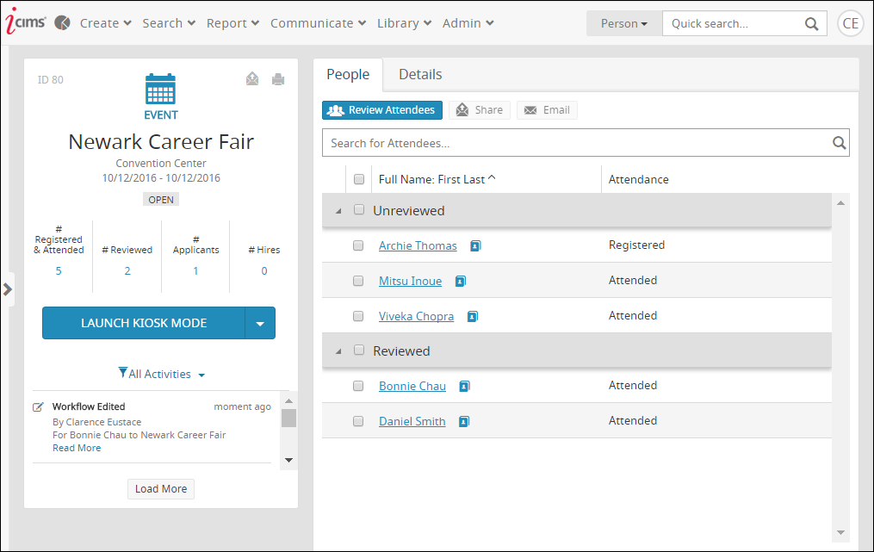
Connect Event Management
Connect only
Connect users can take advantage of a new Event Profile, which is used to store information about hiring events and recruitment marketing campaigns.
Events can be easily shared through portal links and QR codes, and an event can be launched into Kiosk Mode directly from the Event Profile.
Recruiters can also easily view event attendees who have registered for and attended the event on the People Tab.

Slide 10
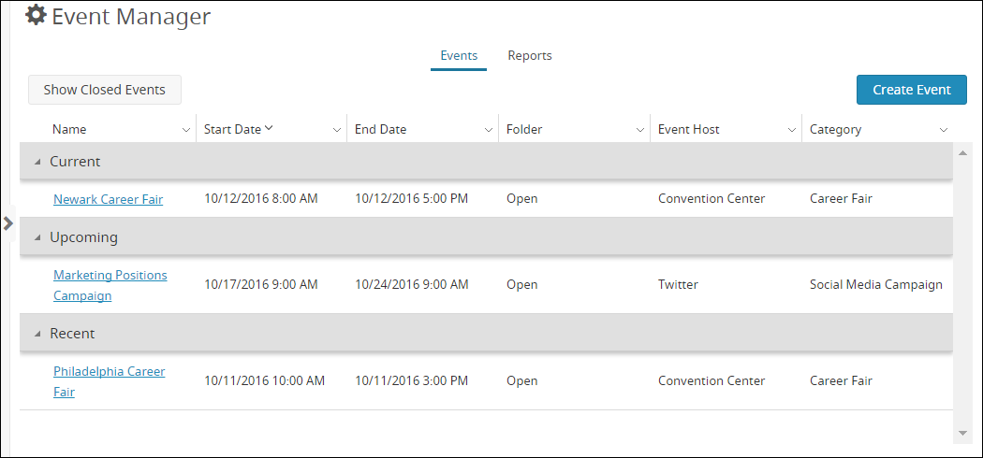
Connect Event Management (Cont’d)
On by default
Connect customers also have access to the Event Manager page, where current, upcoming, and recent events are displayed.
On the Reports tab, customers can also view metrics from recent events, providing insight into the success of their events and the organization’s overall event strategy.

Slide 11
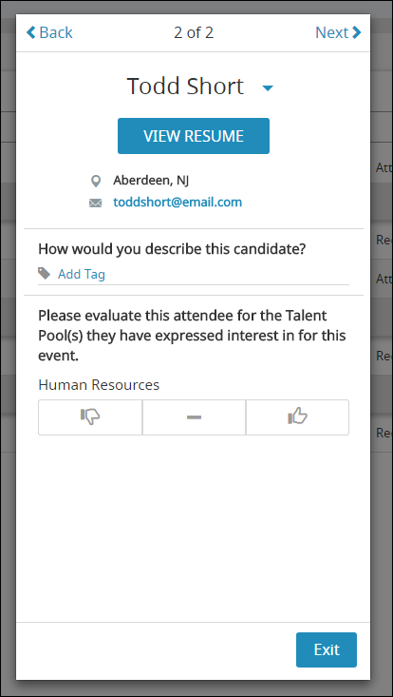
Connect Recruiter Review
Connect only
While at an event interacting with candidates, recruiters can access a Review Mode on their mobile device and provide feedback on candidates in real time.
Recruiter Review Mode is launched using the Review Attendees button on the People Tab of the Event Profile.
In this screen, recruiters can add tags to a candidate, or assess a candidate’s fit for talent pools the candidate has expressed interest in.
Note: Recruiter Review Mode can also be accessed on a desktop browser.

Slide 12
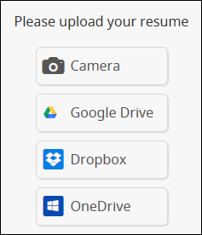
Connect Kiosk Mode Enhancements
Connect only
Through Kiosk Mode, recruiters can easily capture candidate information at events via tablets and/or traditional computers.
Beginning in 16.4, Kiosk Mode is now:
Launched from the new Event Profile
Configured right in the Platform
Candidates can upload their resume at the kiosk by:
Locating it through cloud storage (Microsoft OneDrive new for 16.4)
Taking a photo of their paper version through the new Camera option

Slide 13
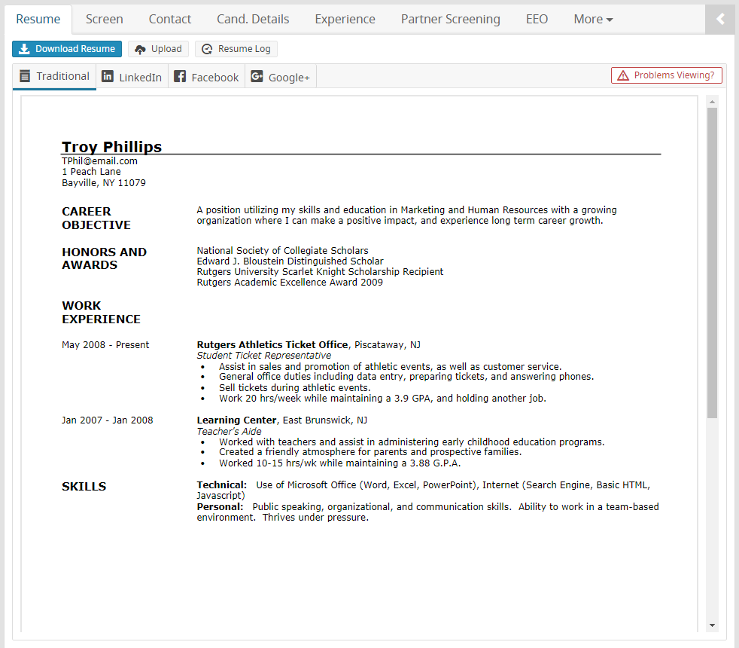
Resume View Performance Improvement
Resume view loading time has been noticeably improved, allowing users to more quickly view candidates’ resumes throughout the iCIMS Talent Platform.
In rare instances, a resume may display unusually in the improved resume view framework. (For example, the spacing between words may be affected, or the resume may be unreadable.)
If a user accesses a resume that is unreadable, they should select the Problems Viewing? button, located to the top right of the resume.

Slide 14
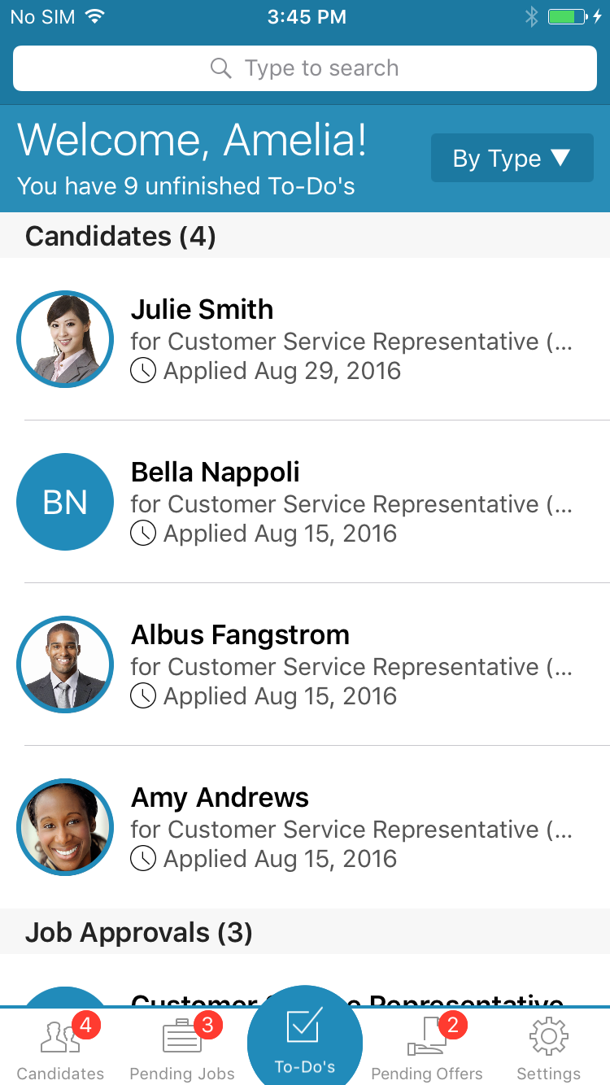
In Case You Missed It: iCIMS Mobile Hiring Manager App
Requires Setup
The iCIMS Mobile Hiring Manager App makes it faster and easier for you to hire great candidates for open jobs. Available in the US, UK, and Canadian App Stores for iOS devices, the app includes the following key features:
Personal To-Do List
Job and Offer Quick Approval
Mobile Candidate Review
…and more!
Check out iCIMS Knowledge Base for more information on getting started with iCIMS Mobile Hiring Manager!
Introduction to the App
User Admin Guide to the App

Slide 15
In Case You Missed It: Other Notable Features
Organizations can now prevent users from hiring candidates for jobs that have no open positions. This configuration is off by default, but can be enabled by user admins.
Organizations can now automatically add a BCC recipient on all email communications out of the Platform. This configuration is off by default, and can be enabled by iCIMS Technical Support.
Many Marketplace Products have been renamed in the Platform to better align with iCIMS Marketplace.
Drug Screens have been merged with Background Screens, meaning that the Drug Screen panel will no longer display and any Drug Screen results your organization may have can now be found within the Background Screen panel.

Slide 16
Additional Release Resources
Release Notes
In-depth details on all new release features, including detailed setup information for user admins.
See https://icimshub.force.com/customer/releaseresources
iCIMS iCARE Site, Knowledge Base, and Training Videos
How-to articles, video trainings, and other useful information in an easy-to-search format.
See https://icimshub.force.com/customer
iCIMS Browser Support Policy
Information about supported web browsers, updated by release or as needed.
See http://media.icims.com/training/Training/Documentation/iCIMS_Browser_Support_Policy.pdf
This information has been provided ahead of release and is subject to change. For more information, please speak with your Account Manager or visit the iCIMS Release Resources site for updated information as it becomes available.

