Slide 1
iCIMS Fall 2015 Update: Highlights
Last Updated Date: 11/11/2015

Slide 2
Introducing the Fall 2015 Update
iCIMS Fall 2015 Update provides new self-administration and automation tools that allow our customers to hire best-fit talent faster and report on recruitment success more efficiently. Designed with flexibility in mind, the features included in this update require little to no preparation on behalf of the customer.
User Admins can now create, store, and maintain Dynamic Approval Lists for jobs, offers, and more based on hierarchies and other relationships within their organization.
Easy-to-use, flexible, and powerful Scheduled Reports allow User Admins to schedule recurring reports, which are emailed at specific intervals to any stakeholders.
Applicants and Platform users who forget or want to update their passwords can use iCIMS Streamlined Password Reset process to restore their system access. This convenient password reset process removes obstacles that prevent candidates from completing applications and reduces the need for client or iCIMS HelpDesk support.

Slide 3
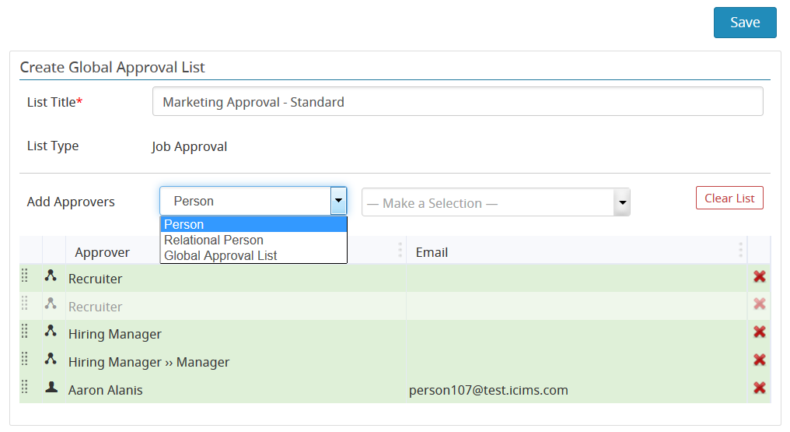
Dynamic Approval Lists
User Admins can now create and maintain Global Approval Lists for jobs, offers, and other approvals within System Configuration.

Slide 4
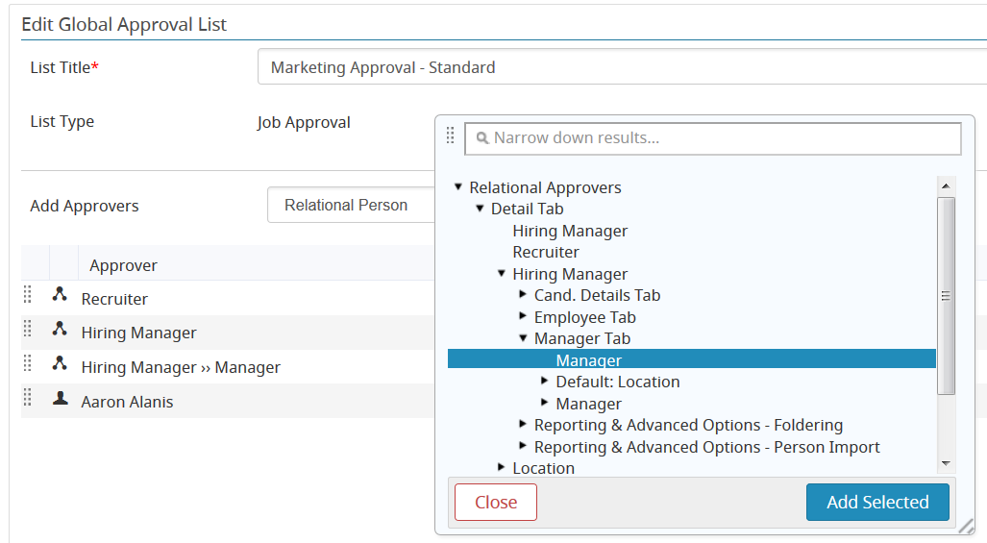
Dynamic Approval Lists
These approval lists can include specific people or can be based on hierarchies and other relationships within the organization.

Slide 5
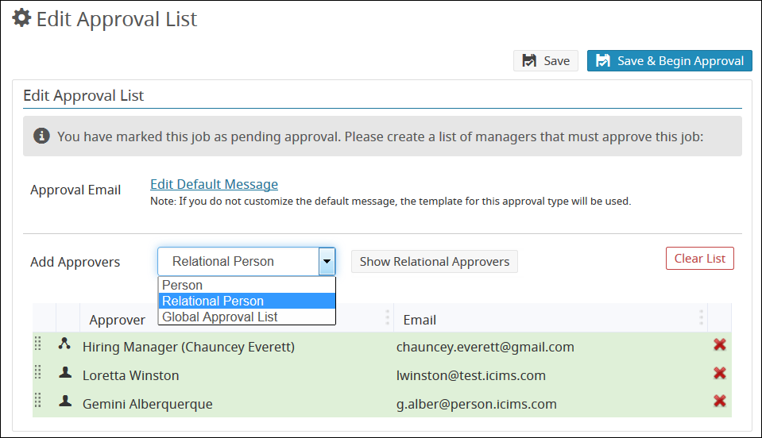
Dynamic Approval Lists
The recruiter approval experience has been improved as well. When routing an item for approval, recruiters with appropriate permissions can now add Relational Persons to the approval list. Relational Persons will resolve with the appropriate individual when the approval is sent.

Slide 6
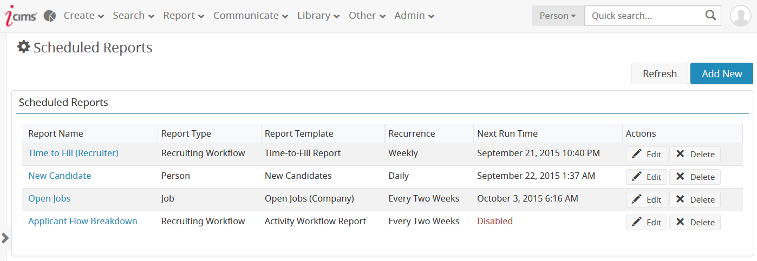
Scheduled Reports
User Admins can now easily schedule and manage recurring emailed reports via Admin > Tools > Schedule Reports.
Scheduled reports may be easily reviewed, modified, disabled, or deleted from this page, as well.

Slide 7
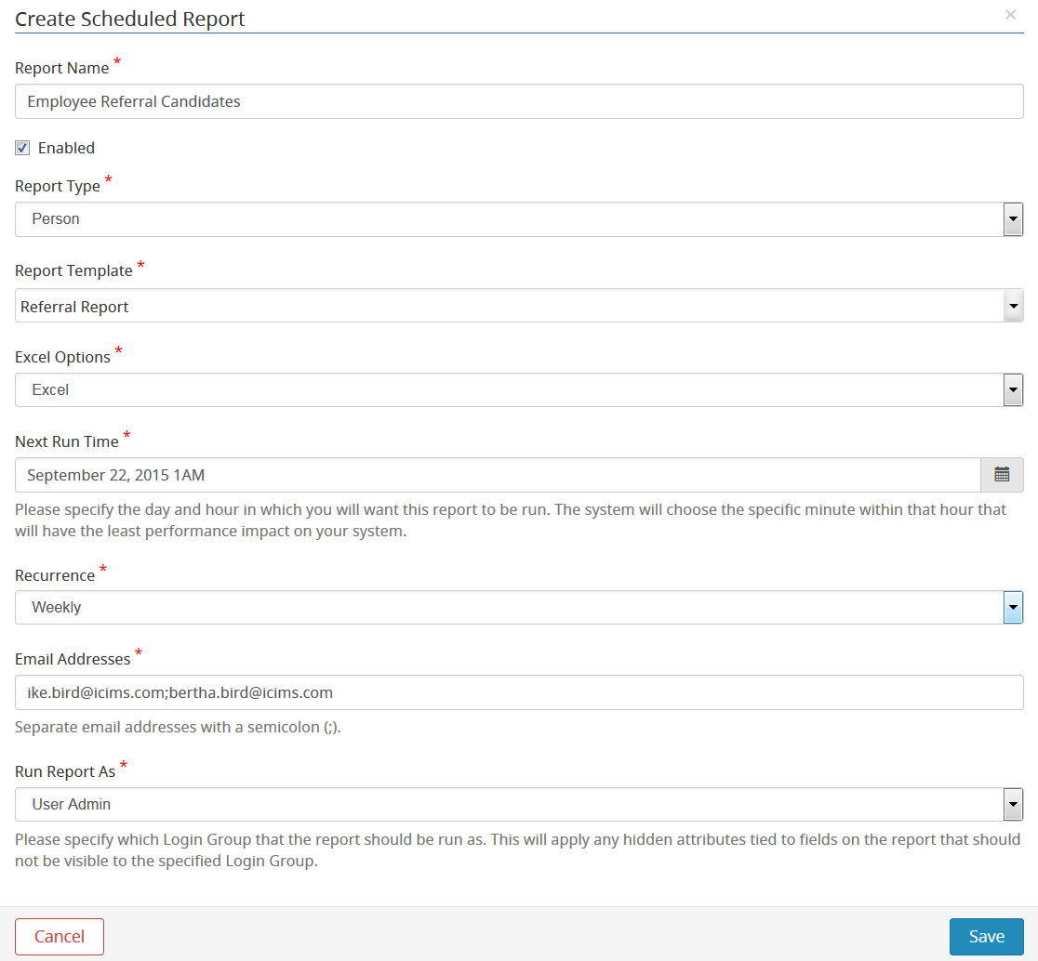
Scheduled Reports
The easy-to-use Create Scheduled Report builder makes it simple for the User Admin to schedule reports to run at specific times and email the results on a recurring basis.
Reports may be emailed to any desired stakeholders, including those who do not use the system.

Slide 8
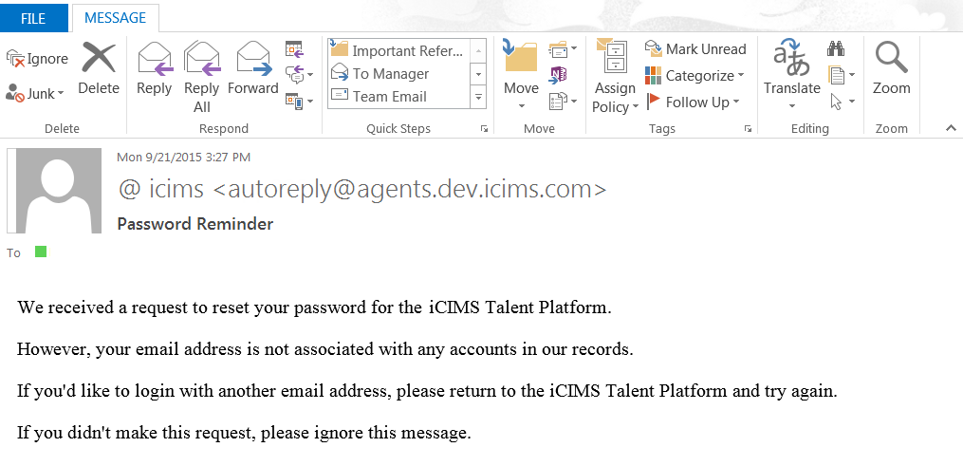
Streamlined Password Reset
Users and candidates who enter a valid email address that is not associated with an existing account into a Password Reset field will now receive a message indicating that a match was not found.

Slide 9
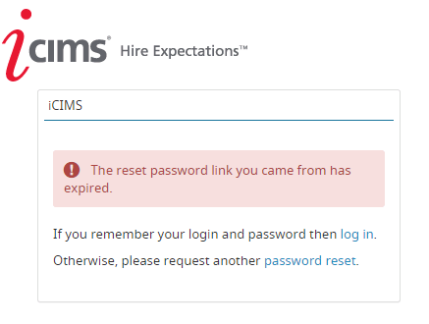
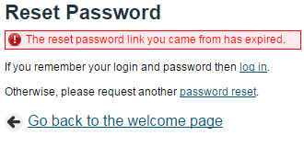
Streamlined Password Reset
Further, the landing page for expired password reset links now provides clearer messaging to assist users and candidates in successfully logging in or restarting the password reset process.

Slide 10
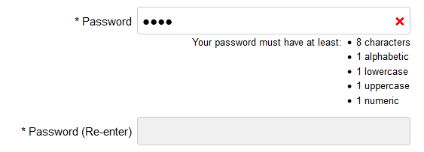
Streamlined Password Reset – Security Enhancements
For Platform users and candidates, new minimum password security settings will improve system and data security. To provide client preparation time, this update will be rolled out after the initial release.
Clients may determine how often and whether all users and candidates must change their passwords in conversation with the iCIMS HelpDesk.
All Platform users and candidates with passwords that do not meet minimum security requirements will be prompted to update to a more secure password upon login.
When a new password is composed, the system will indicate which default password criteria are not yet met. When a secure password has been provided, a green check will display.

Slide 11
Additional Release Resources
New Feature Focus Release Notes
In-depth details on all new update features, including detailed setup information for User Admins
See http://care.icims.com/Releases/Current-Release/Release-Resources
iCIMS Knowledge Base
How-to articles and other useful information in an easy-to-search format
See http://icims.com/kb
iCIMS University
Live webinars and video trainings covering many aspects of the iCIMS Talent Platform
See http://care.icims.com/iCIMS-U
This information has been provided ahead of update and is subject to change. For more information, please speak with your Client Relationship Director or visit the iCIMS Release Resources site for updated information as it becomes available.

