Slide 1
iCIMS Social Distribution Update: Highlights
Last Updated Date: 2/26/2016

Slide 2
Introducing the iCIMS Social Distribution Update
iCIMS Social Distribution enables organizations to source, recruit, and hire the best talent through the use of social networks. With manual and automated job publishing capabilities, iCIMS Social Distribution allows users to attract passive candidates through their social networks and grow their organization’s talent pipeline for current and future job opportunities.
The update to iCIMS Social Distribution provides the same powerful functionality with refreshed branding and design that more closely resembles the look and feel of other iCIMS Talent Platform solutions. Additionally, iCIMS is constantly investing in performance and stability improvements to benefit customer growth and scaling.

Slide 3
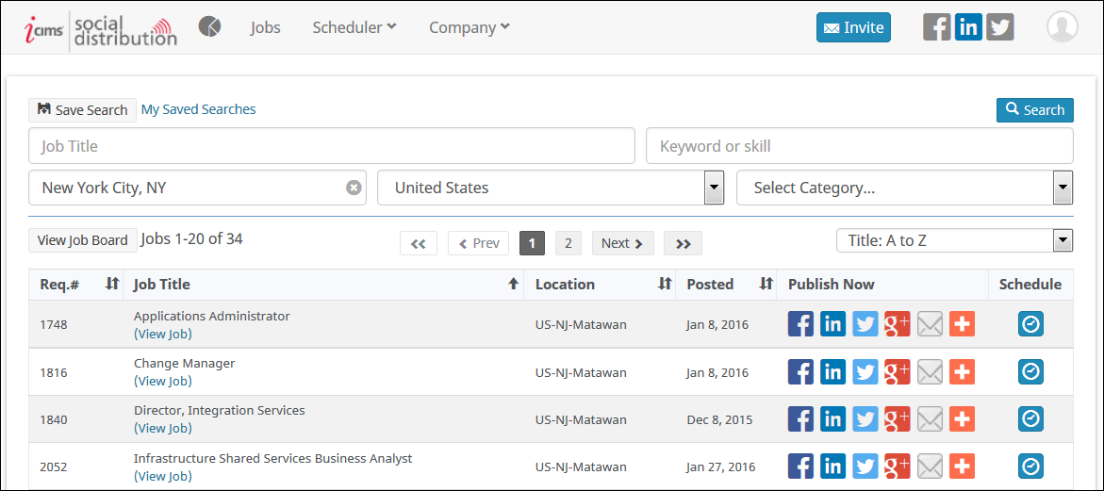
Improved User Interface
The iCIMS Social Distribution Update provides the same valuable social job publishing capability with a new look that is more closely aligned with other iCIMS Talent Platform solutions.
Notable changes to the look and feel include a new menu bar, an updated color scheme, and the removal of extraneous lines.

Slide 4
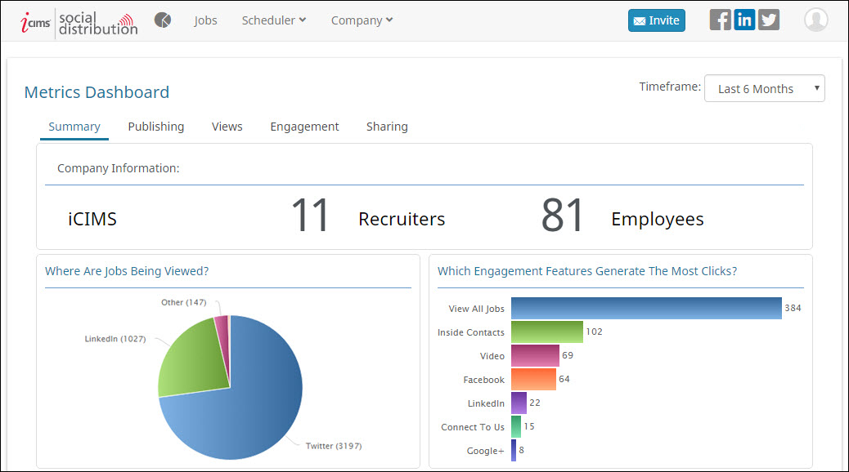
Analytics Available via Metrics Dashboard
Key metrics for Social Distribution, which were formerly accessed from the Analytics Tab, are now available via the Metrics Dashboard icon on the left side of the menu bar.

Slide 5
Updated Scheduler and Company Tabs
Users can now access the New Publisher and New Scheduled Post pages from anywhere within iCIMS Social Distribution, using dropdown options from the Scheduler menu.
Similarly, users with appropriate permissions can access the Company Branding and Manage Templates pages at any time, using dropdown options from the Company menu.

Slide 6
Additional Release Resources
Release Notes
In-depth details on all new update features, including detailed setup information for user admins.
See https://icimshub.force.com/customer/releaseresources
iCIMS iCARE Site, Knowledge Base, and Training Videos
How-to articles, video trainings, and other useful information in an easy-to-search format.
See https://icimshub.force.com/customer
iCIMS Browser Support Policy
Information about supported web browsers, updated by release or as needed.
See http://media.icims.com/training/Training/Documentation/iCIMS_Browser_Support_Policy.pdf
This information has been provided ahead of release and is subject to change. For more information, please speak with your Account Manager or visit the iCIMS Release Resources site for updated information as it becomes available.

